Slide 1
ASSIGNMENT

Slide 2
POISSON DISTRIBUTION

Slide 3
Poisson distribution
Poisson distribution is a probability distribution that is used to show how many times an event is likely to occur over a specified period.
The Poisson distribution is a discrete function, meaning that the variable can only take specific values in a list. Put differently, the variable cannot take all values in any continuous range. For the Poisson distribution the variable can only take the values 0, 1, 2, 3, etc., with no fractions or decimals.

Slide 4
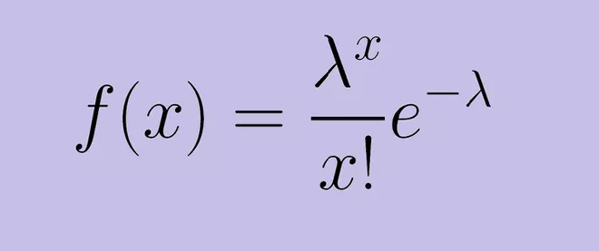
EQUATION
A random variable X is said to follow the poisson distribution if its pdf
Where:
e is Euler's number (e = 2.71828...)
x is the number of occurrences
x! is the factorial of x
λ is equal to the expected value (EV) of x when that is also equal to its variance

Slide 5
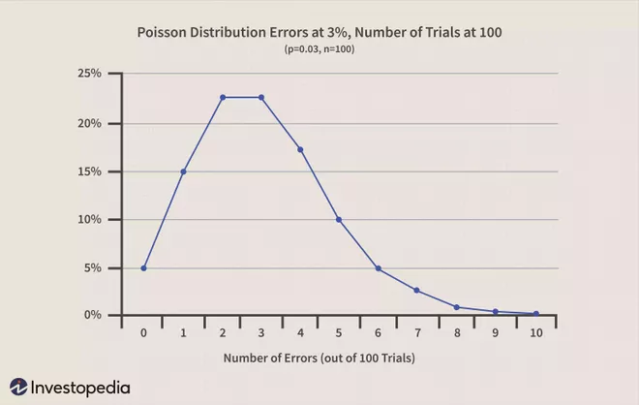
GRAPH:
Let’s continue to assume we have a continues variable x and the poisson distribution,it will be a continues curve,asfollows:
.

Slide 6
Example
The Poisson distribution may be useful to model events such as:
The number of telephone calls in a week.
Number of industrial accidents per month in a manufacturing plant.
The number of patients arriving in an emergency room between 10 and 11 pm
The number of laser photons hitting a detector in a particular time interval .
In general it is seen that the number of occurrence of a rare event in a specified short period is found to follow . the poison distribution.

Slide 7
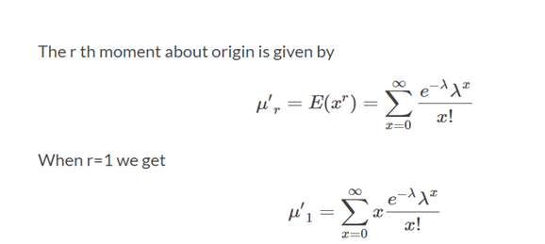

Moments of Poisson distribution
x^r

Slide 8

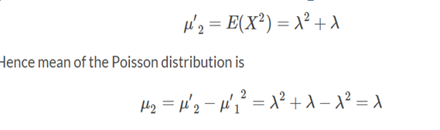
Hence mean of the Poisson distribution is lambda
When r=2
we get,
Thus the mean and varience of poisson distribution are same ie,λⁿ

Slide 9
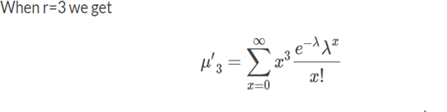

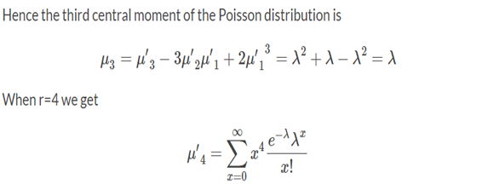

Slide 10


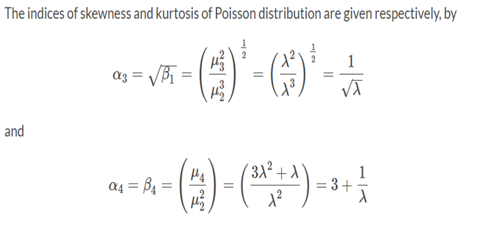
the fourth central moments

Slide 11
Poisson Distribution Example
1.The average number of homes sold by the Acme Realty company is 2 homes per day. What is the probability that exactly 3 homes will be sold tomorrow?
Solution: This is a Poisson experiment in which we know the following:
λ = 2; since 2 homes are sold per day, on average.
x = 3; since we want to find the likelihood that 3 homes will be sold tomorrow.
e = 2.71828; since e is a constant equal to approximately 2.71828.

Slide 12
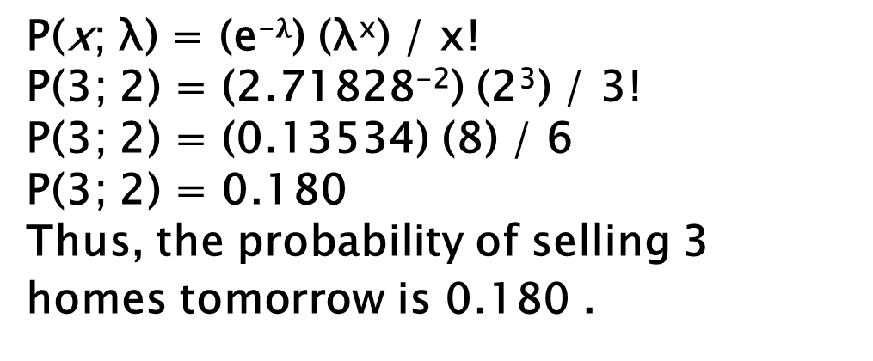
P(x; λ) = (e⁻$λ$) (λ^{x}) / x!
P(3; 2) = (2.71828⁻²) (2³) / 3!
P(3; 2) = (0.13534) (8) / 6
P(3; 2) = 0.180
Thus, the probability of selling 3 homes tomorrow is 0.180 .

Slide 13
2. Suppose the average number of lions seen on a 1-day safari is 5. What is the probability that tourists will see fewer than four lions on the next 1-day safari?
Solution: This is a Poisson experiment in which we know the following:
λ = 5; since 5 lions are seen per safari, on average.
x = 0, 1, 2, or 3; since we want to find the likelihood that tourists will see fewer than 4 lions; that is, we want the probability that they will see 0, 1, 2, or 3 lions.
e = 2.71828; since e is a constant equal to approximately 2.71828.
To solve this problem, we need to find the probability that tourists will see 0, 1, 2, or 3 lions.

Slide 14
Thus, we need to calculate the sum of four probabilities: P(0; 5) + P(1; 5) + P(2; 5) + P(3; 5). To compute this sum, we use the Poisson formula:
P(x < 3, 5) = P(0; 5) + P(1; 5) + P(2; 5) + P(3; 5)
P(x < 3, 5) = [ (e⁻⁵)(5⁰) / 0! ] + [ (e⁻⁵)(5¹) / 1! ] + [ (e⁻⁵)(5²) / 2! ] + [ (e⁻⁵)(5³) / 3! ]
P(x < 3, 5) = [ (0.006738)(1) / 1 ] + [ (0.006738)(5) / 1 ] + [ (0.006738)(25) / 2 ] + [ (0.006738)(125) / 6 ]
P(x < 3, 5) = [ 0.0067 ] + [ 0.03369 ] + [ 0.084224 ] + [ 0.140375 ]P(x < 3, 5) = 0.2650
Thus, the probability of seeing at no more than 3 lions is 0.2650.

Slide 15
3. A computer crashes once every 2days on average. What is the probability of there being 2 crashes in one week?
Soln:
P2=(3.5)^2/2!
=0.185

Slide 16
Thank you..

